Slide 1
Angular basics
How to start, project structure

Slide 2
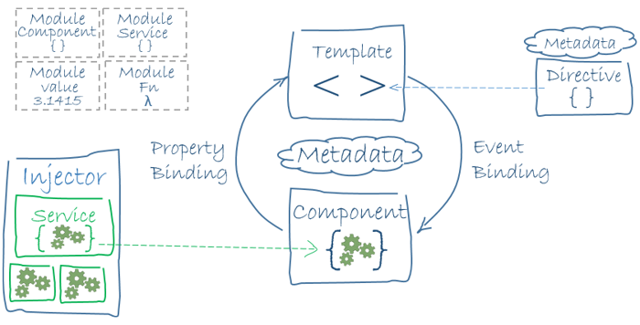
Angular app architecture

Slide 3
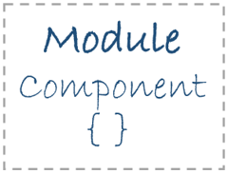
Module
Angular apps are modular and Angular has its own modularity system called NgModules.
Every Angular app has at least one NgModule class, the root module, conventionally named AppModule.

Slide 4
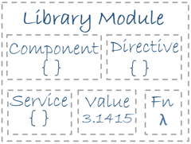
Angular libraries
Angular ships as a collection of JavaScript modules. You can think of them as library modules.
Each Angular library name begins with the @angular prefix.
You install them with the npm package manager and import parts of them with JavaScript import statements.

Slide 5
Components
A component controls a patch of screen called a view. You define a component's application logic - what it does to support the view - inside a class. The class interacts with the view through an API of properties and methods.
Angular creates, updates, and destroys components as the user moves through the application.

Slide 6
Templates
You define a component's view with its companion template. A template is a form of HTML that tells Angular how to render the component.
A template looks like regular HTML, except for a few differences.

Slide 7
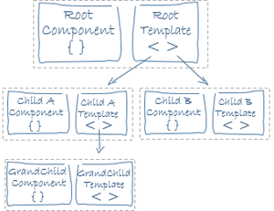
Components tree

Slide 8

Metadata
Metadata tells Angular how to process a class. Your app consists of classes that has no evidence of a framework, no “Angular” in it at all. In TypeScript, you attach metadata by using a decorator.

Slide 9
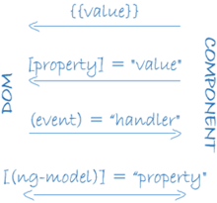
Data binding

Slide 10

Services
Service is a broad category encompassing any value, function, or feature that your application needs.
Almost anything can be a service. A service is typically a class with a narrow, well-defined purpose. It should do something specific and do it well.

Slide 11
We skipped for now...
Dependency injection
Directives
Component interaction
Lifecycle hooks
Http
Router
Testing
Pipes
Forms

Slide 12
Q&A

